Slide 1


Slide 2

MICROSOFT WORD

Slide 3
WHAT IS A MICROSOFT WORD
Microsoft word is document use to Write any data in any font, size, colour.
It is used for Question papers, letters,Information etc
You will learn more about this in upcoming slides.

Slide 4
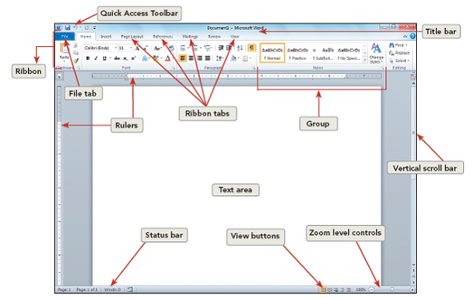

Slide 5
01
Creating word file

Slide 6
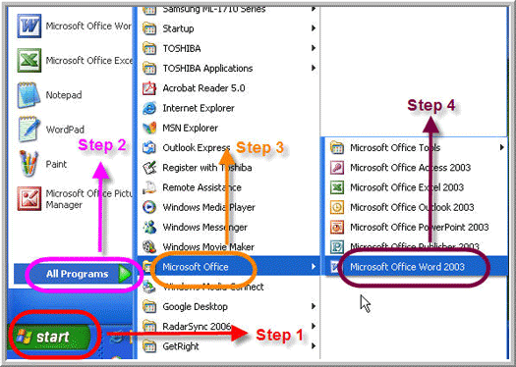
Steps for Creating Word file:
Go to start
All Programs
Microsoft office
Microsoft word

Slide 7
CHANGE THE FONT AND SIZE

Slide 8

Steps to Change size of text : Type text
Go to home
Dropdown value of number
Change the size

Slide 9
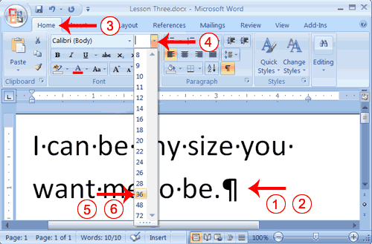


Slide 10

Steps to Change font of text : Type text
Go to home
Dropdown value of font name
Change the Font

Slide 11
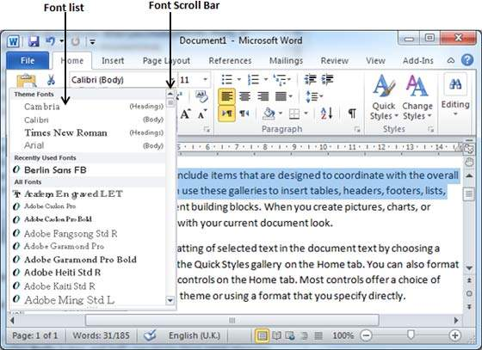


Slide 12
To insert the picture

Slide 13
Steps to Insert Pictures : Go to Insert
Picture
Click on picture folder
Click on Image
Insert

Slide 14
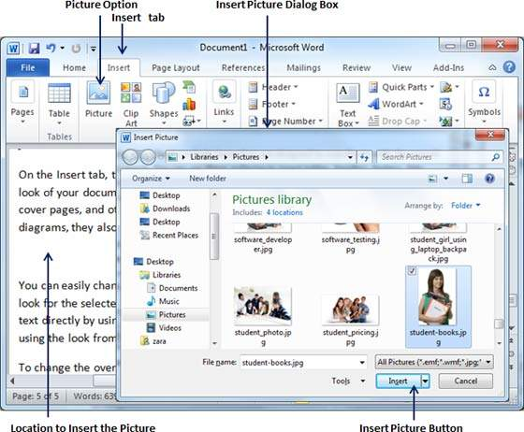

Slide 15
TO INSERT THE SHAPES

Slide 16

Steps to Insert Shapes: Go to Insert
Shapes
Click on any shape
Drag on screen the shape
Shape inserted

Slide 17
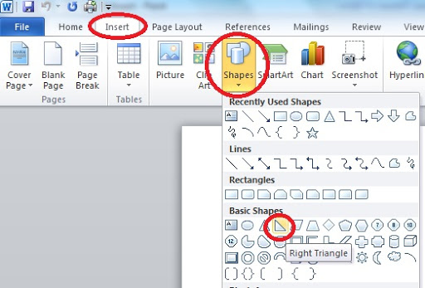

Slide 18
TO SAVE DOCUMENT

Slide 19

Steps to Save document: Go to File
Ctrl +s = save document
Save as
Save the name
Select folder to save
Save

Slide 20
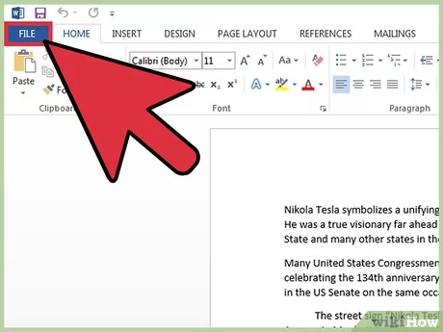
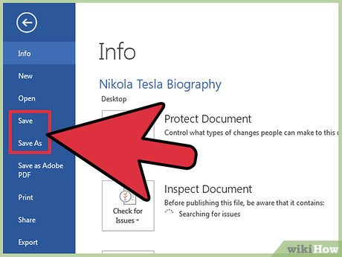

Slide 21
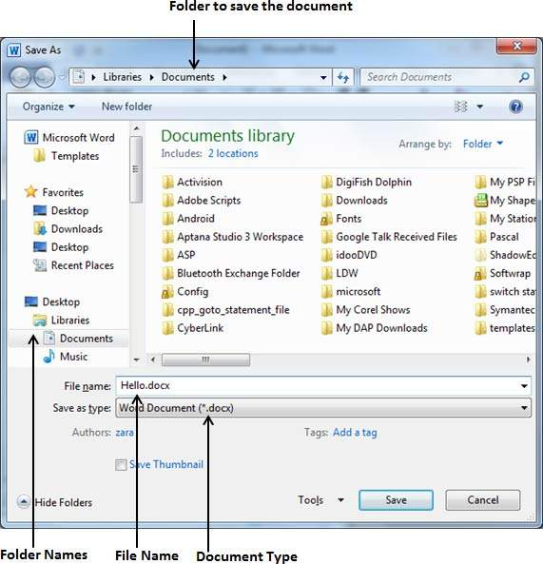


Slide 22
HEADER & FOOTER

Slide 23

What is Header & Footer?
Header – It is upper part of page.
To write Heading part for file
Footer - It lower Part of page to write any Ending Important Statement.

Slide 24
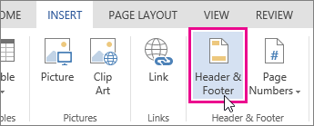
Steps to take Header & footer file : Go to Insert
Header & Footer
Added

Slide 25
TO INSERT THE SYMBOLS

Slide 26
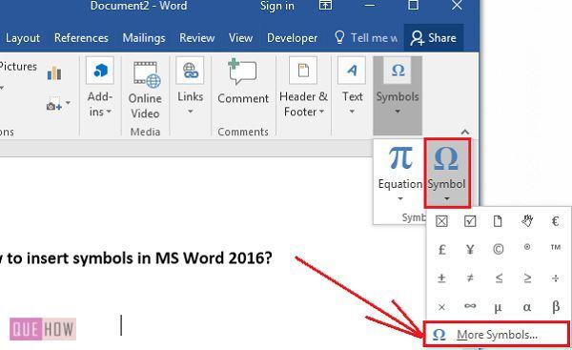
Steps to take Symbol in file : Go to Insert
Symbols
Added

Slide 27
TO ADD HYPERLINK

Slide 28
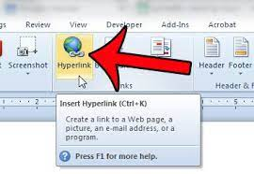
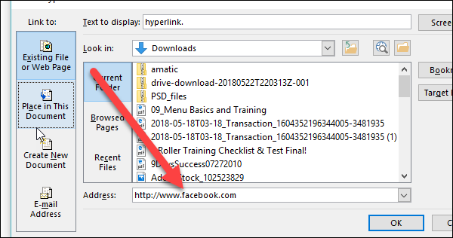
Steps to take Hyperlink file : Go to Insert
Hyper link
Add the website link
save

Slide 29
ADD THE TABLE

Slide 30
Steps to Add Table in word : Go to Insert
Table
Click on number of row and columns
Add number of rows and columns
Or
Click on Insert table
Table Added

Slide 31
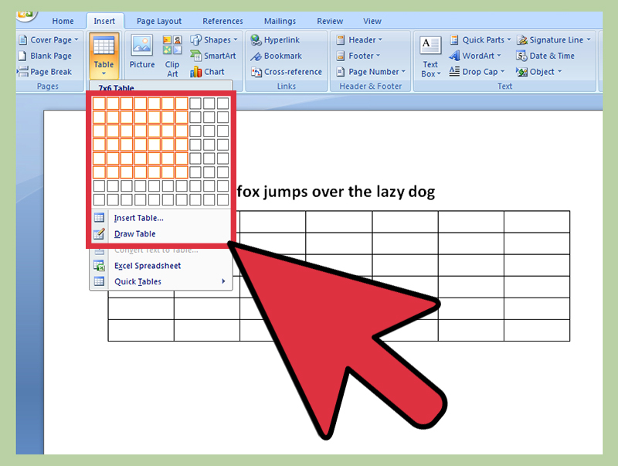

Slide 32
Thank-you

